Slide 1
SSW-555: Agile Methods for Software Development
Dynamic Systems Development Method (DSDM)
Prof. Jim Rowland
Software Engineering
School of Systems and Enterprises
Notes:
DSDM is an evolution of the Rapid Application Development (RAD). DSDM is an alternative to Extreme Programming, Feature Driven Development (FDD), and Scaled Agile Framework (SAF).

Slide 2
Acknowledgements
This lecture includes material from:
http://www.codeproject.com/Articles/5097/What-Is-DSDM
Rapid Application Development, James Martin, ISBN-13: 978-0023767753

Slide 3
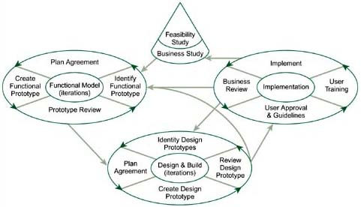
Today’s topics
Rapid Application Development (RAD)
Dynamic Systems Development Method (DSDM)
Core techniques of RAD and DSDM

Slide 4
Rapid: the precursor to Agile (1970s)
The traditional software development model was based on a Customer-Supplier relationship
Used a traditional engineering model
Create design, construct solution, and deliver to customer
Fixed contract between customer and supplier
E.g. big government agency and software supplier
Fixed schedule, e.g. 1-2 years
Requirements negotiated up front
Customers and developers were independent and frequently didn’t trust each other

Slide 5
Rapid: the precursor to Agile (1980s)
Companies created in-house IT departments
e.g. create new reports from an existing database or automate manual processes
Customers and suppliers work for the same company
In-house development could use a different model
Schedule could trade features for speed
Requirements could be changed during development
No need to renegotiate contract terms and conditions
Customers and developers could work together

Slide 6
Rapid Application Development (RAD)
Originally developed in the 1970s by Dan Gielan at New York Telephone Co's Systems Development Center
Later codified by James Martin at IBM in his book Rapid Application Development, 1991
Reduces development time by:
Substituting prototypes for requirements specifications
Using existing databases, data models, and tools
Trading features for speed
Implementing most important features first
Adding more features incrementally

Slide 7
RAD Process
Requirements Planning phase – Users, managers, and IT staff members discuss requirements
User design phase – Users interact with systems analysts and develop reusable (evolutionary) prototypes
Construction phase – Users continue to participate and can still suggest changes or improvements as actual screens or reports are developed
Cutover phase – Data conversion, full-scale testing, system changeover, user training
Repeat until done

Slide 8
RAD Techniques
Facilitated joint workshops (JAD)
Customers and developers
Evolutionary prototyping evolving into finished products
Time boxed incremental delivery
Strict schedules that can’t be changed
Drop features rather than miss the deadline
Small teams including users (6-12)
CASE tools:
Rapid GUI development, e.g. Visual Basic
Assumes simple data models

Slide 9
Dynamic Systems Development Method (DSDM)
Developed in England in the 1990s
Formalization of Rapid Application Development (RAD)
DSDM Consortium:
Created in 1994 by 16 European companies
Purpose: "jointly developing and promoting an independent RAD framework" by combining their best practice experiences
Publishes standards and supporting material

Slide 10
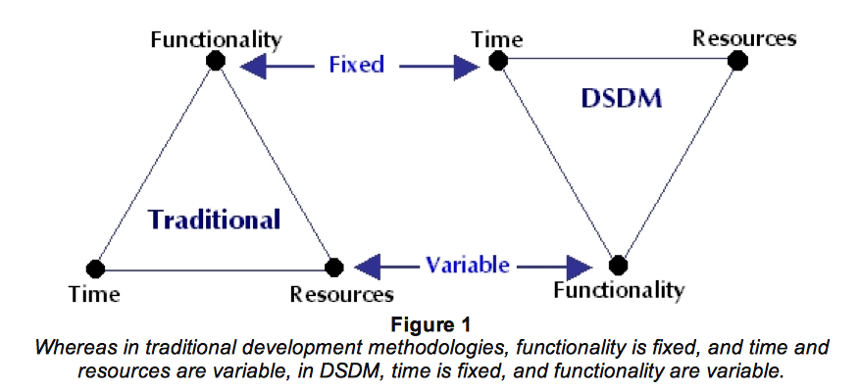
Dynamic Systems Development Method (DSDM)
Source: http://www.codeproject.com/Articles/5097/What-Is-DSDM

Slide 11
DSDM Principles
Active user involvement is imperative
DSDM teams must be empowered to make decisions
The focus is on frequent, incremental delivery of products
Fitness for business purpose is the essential criterion for acceptance of deliverables, i.e. meet the business need
Iterative and incremental development is necessary to converge on an accurate business solution
All changes during development are reversible
Notes:
Developed in England in the 1990s
Formalization of RAD
DSDM Consortium:
Created in 1994 by 16 European companies
Purpose: "jointly developing and promoting an independent RAD framework" by combining their best practice experiences
Publishes standard and supporting material

Slide 12
DSDM Principles
Requirements are baselined only at a high level
Use prototypes to define the details
Testing is integrated throughout the lifecycle
A collaborative and co-operative approach between all stakeholders is essential,
Customer and supplier are on the same team
80/20 Rule – 80% of the solution can be build in 20% of the time. Prioritize the other 20%
Notes:
Developed in England in the 1990s
Formalization of RAD
DSDM Consortium:
Created in 1994 by 16 European companies
Purpose: "jointly developing and promoting an independent RAD framework" by combining their best practice experiences
Publishes standard and supporting material

Slide 13
DSDM Process
Start Here
Source: Highsmith chapter 18

Slide 14
Pre-project phase
Develop a high level concept
Decide whether to start project
Does it make sense?
Is it technically feasible?
Identify stakeholders, especially:
Visionary – driving force behind the project
Project Manager – manages the project and the people
Plan feasibility study

Slide 15
Feasibility Study
Starts with a Facilitated Joint Workshop
Includes users and developers
Produces a Feasibility Report:
Short business case
Evaluate suitability of DSDM
Early investigation of requirements
Can it be accomplished with available time and budget?
Also produces:
Outline plan with schedules and budget
Risk log
May produce a first prototype

Slide 16
Business Study
Another Facilitated Joint Workshop
Go down to the next level of detail
Does this make good business sense?
Produces:
Business Area definition
Prioritized requirements List
Development plan
System architecture definition
Updated risk log

Slide 17
Functional model iteration
Produce functional model of system:
Prototypes
Early versions of the system’s functionality
Documentation
4 activities:
Identify what is to be produced
Agree how and when to do it
Create the product
Check that it has been produced correctly

Slide 18
Design and build iteration
Continue to refine the current prototype
System development
Test often
Result is the current release of system

Slide 19
Implementation (Deployment)
Installation and Deployment
Represents cutover to operations
Installation of the completed code
Produce documentation
Train users

Slide 20
Post-project phase
Support and maintenance of product
Post-project review
DSDM waits until the end of the project to review
eXtreme Programming reviews throughout the project

Slide 21
Core techniques of DSDM and RAD
MoSCoW
Time boxing
Evolutionary prototyping
Facilitated Joint Workshops (JAD)

Slide 22
MoSCoW – 80/20 prioritization
Recall that DSDM trades features for time/schedule
Prioritization of requirements
Must have: system is useless without these features
Should have: important requirements, but there is a work-around so that these can be left out for now
Could have: consider for future iterations
Want to have (Waiting list/Won’t have): least important
At each iteration the team decides which requirements to include
Focus on must-haves (60%)
Must include some others (20% should-haves, 20% could-haves)

Slide 23
Time boxing
Set deadlines and adjust requirements and resources
Each increment has a fixed deadline
Each increment should deliver something useful
Development team may drop some deliverables in order to meet deadline
Drop requirements
Acquire third party solution for requirements
Add resources

Slide 24
Prototyping
Rather than spend all the effort to develop a complete system, build a quick prototype to test its feasibility
Prototypes are widely used in most forms of engineering
Low-fidelity (throwaway) prototyping
Quick demonstration of a feature
Result is not useful for development into a product or service
Evolutionary (rapid) prototyping
Rapid construction of a simple feature, often done with special tools
Result may be modified to evolve into the final product or service

Slide 25
Joint Application Design (JAD)
Developed by Chuck Morris and Tony Crawford at IBM in late 1970s
IBM owned 90% of the computing market in the early 1970s
Bring users and developers together to solve a problem
Facilitated joint workshops:
Small team of users and developers work offsite for 1-5 days
Focus on most important features
May create low-fidelity prototypes
May produce detailed specifications of features and functions

Slide 26

Questions?

